Slide 1
Mental Health and Machine Learning in companies
How Machine Learning is implemented for predicting Mental Health of Employees?

Slide 2
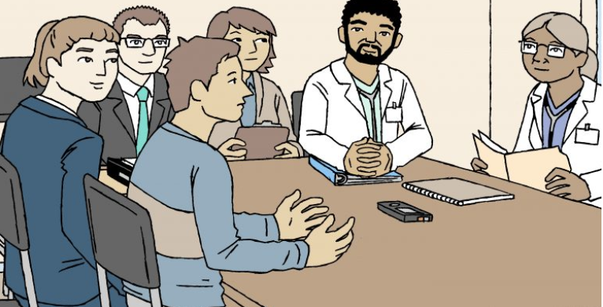

Slide 3
Mental Health Introduction
Mental health includes our emotional, psychological, and social well-being. It affects how we think, feel, and act. It also helps determine how we handle stress, relate to others, and make choices in life.
It is crucial and challenging at every stage of life, from childhood and adolescence through adulthood and specifically, in the case of working professionals.
The modernized (hectic) lifestyle and workload take a toll on people over time making them more prone to mental disorders like mood disorder and anxiety disorder. Thus, the risk of mental health problems increases in working professionals.
To deal with this problem industries provide mental health care incentives to their employees, but it is not enough to deal with the problem.

Slide 4
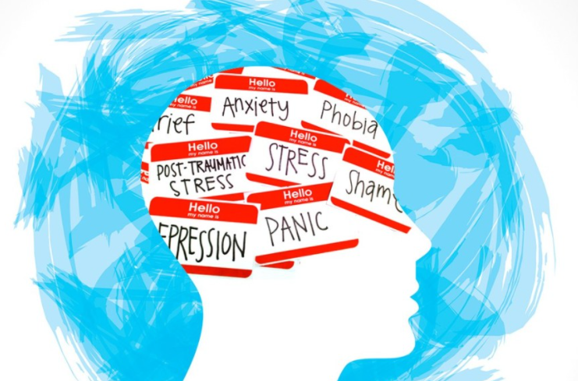

Slide 5
Mental Health and Machine Learning
Machine Learning (ML), as one of the most recent generations of AI technologies, has demonstrated superior performance in many real-world applications ranging from computer vision to healthcare.
Neuroscientists and clinicians around the world are using machine learning to develop treatment plans for patients and to identify some of the key markers for mental health disorders before they may set in.
One of the benefits is that machine learning helps clinicians predict who may be at risk of a particular disorder.

Slide 6
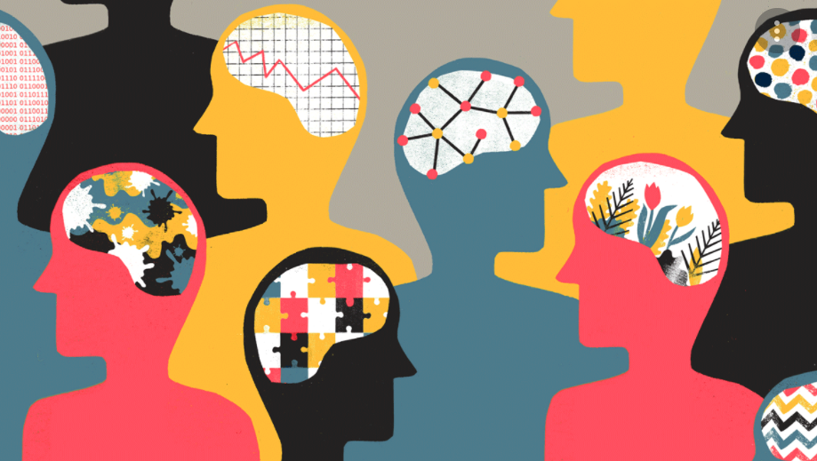

Slide 7
Mental health in case of working professionals
In the context of working professionals, many employees suffer from mental trauma, depression, and anxiety which sometimes lead to extreme steps such as suicide.
There have been various Mental Disorders by which the employees get affected and lack of awareness leads to serious problems in later stages.
There are many surveys, reviews, and research papers written with a solid basis about how machine learning can be implemented for predicting the mental health of employees in different sectors.

Slide 8
Context of the topic
Paper Link: https://ieeexplore.ieee.org/document/9368923
Here, in this article, I will give a review of a paper that implemented numerous Machine Learning algorithms utilizing the data from mental health survey 2019 that contains the data of working professionals for both tech and non-tech company employees.
In the technique, data is processed to find the features influencing the mental health of employees or features that can help to predict the mental health of the employee the feature can be either personal or professional.

Slide 9
In the modernized world, working professionals are under lots of pressure for reasons like peer pressure, short deadlines, competition.
All these things contribute to building up mental stress, which slowly leads to mental health disorders.
In the US 18% of the working population which is 40 million people suffers from mental health disorders.

Slide 10
Machine learning techniques used
Supervised Learning Algorithms were used for the application such as
Support Vector Machines (SVMs),
Logistic Regression,
k Nearest Neighbors (kNN),
Decision Trees,
Random Forest, and
Naive Bayes.

Slide 11
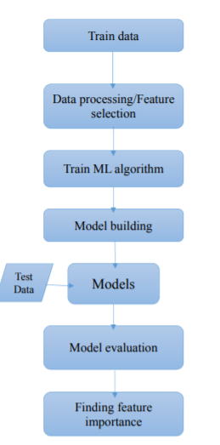

Slide 12
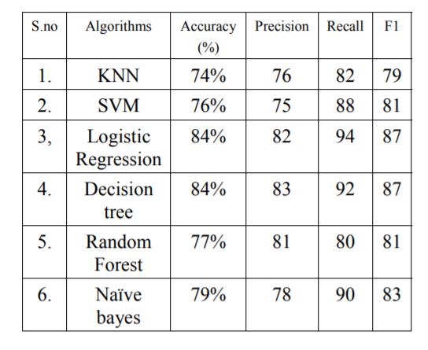
Results

Slide 13
Thus, features affecting the mental health disorder with selected attributes which are,
Whether the company is a Tech company or not.
Age of the employee.
Gender of the employee.
Family history of mental health disorders if any.
Personal history of a mental health disorder.
Personal history of a mental health disorder.
Discussing mental health status with the employer.

Slide 14
Some Related Studies
In the paper, for predicting Anxiety disorder author proposed rules based on factors like persons working place(home or office) and some other personal factors, and the prediction is done using logistic model trees. Which is a hybrid model based on logistic regression and decision trees, and provides better accuracy.
In the paper, the author used a smartphone-based sensor system to monitor or find the changes in the states of bipolar disorder patients. Also, develop an early warning system with recall and precision of about 97%.
In the study, the author predicted generalized anxiety disorder among women and proposed that women are more prone to GAD (generalized anxiety disorder) almost two times than men are; the author was able to predict GAD with 90% accuracy with random forest.

Slide 15
Thank you!

